Slide 1
Hybrid Particulate Collection Technologies

Slide 2
Hybrid Particulate Control Technologies
Fabric filters work well for many fly ashes as long as the cohesive strength of the fly ash is not too high or too low.
However, highly cohesive fly ash can lead to problems with bag cleanability and high pressure drop, and fly ash with low cohesive strength can promote dust bleed through resulting in higher emissions.

Slide 3
Hybrid Particulate Control Technologies
ESPs work well as long as the fly ash resistivity is in the correct range (from about 10⁸ to 10¹¹ ohm-cm), but deteriorate significantly for high- or low-resistivity fly ashes.
Additionally, neither of the technologies will work effectively with the submicron particulate matter for it shall pass straight though the filter material.

Slide 4
Hybrid Particulate Control Technologies
Electrically-charged particles have been found to form highly porous dust layers in fabric filters
Efforts to increase barrier filters efficiency without a corresponding increase in pressure loss have led to the development of electrostatically enhanced fabric filters and so-called hybrid devices

Slide 5
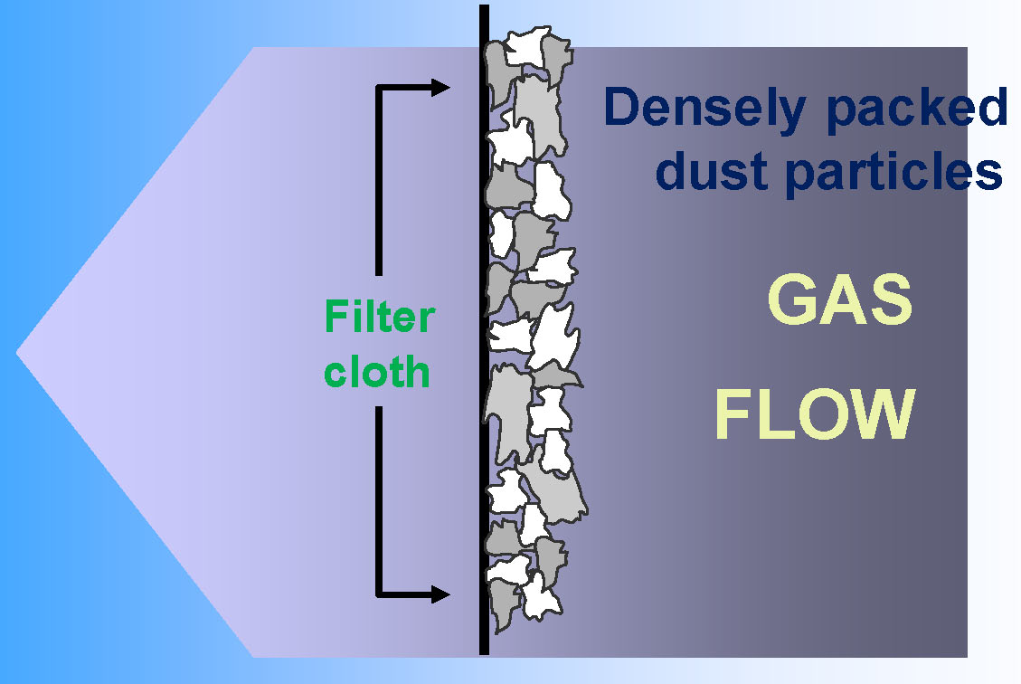
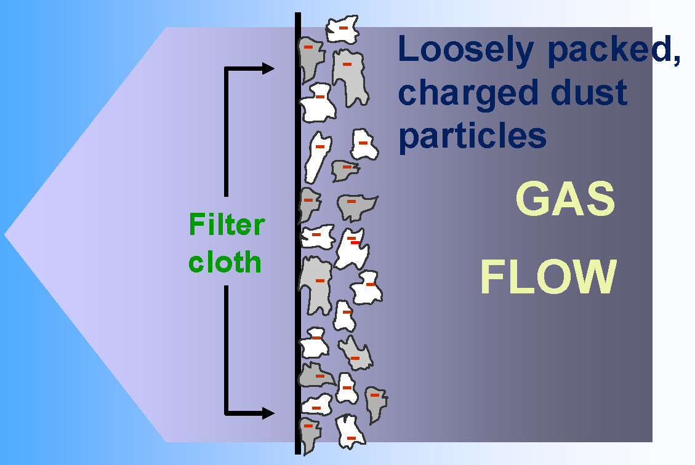
Electrostatically Enhanced FF’s

Slide 6
Hybrid Technologies

Slide 7
Hybrid Particulate Control Technologies
Compact Hybrid Particulate Collector (COHPAC)
Advanced Hybrid
Electrostatically Enhanced Fabric Filter (ESFF) or MAX9
Multi Stage Collector (MSCTM) Technology

Slide 8
Hybrid Particulate Control Technologies - COHPAC
A combination Fabric Filter/ESP hybrid device has been developed by EPRI and is called the Compact Hybrid Particulate Collector (COHPAC):
  This device involves using pulse jet fabric filter to capture dust that escapes an ESP
    COHPAC I involves placing a pulse jet filter downstream from an ESP
    COHPAC II utilizes a fabric filter in place of the last field of an ESP

Slide 9
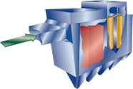
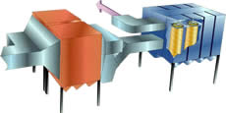
Hybrid Particulate Control Technologies - COHPAC
COHPAC I
COHPAC II

Slide 10
Hybrid Particulate Control Technologies - Advanced Hybrid
Advanced Hybrid
  This technology was patented by the University of North Dakota’s Energy & Environmental Research Center (EERC). Its development was supported by DOE

Slide 11
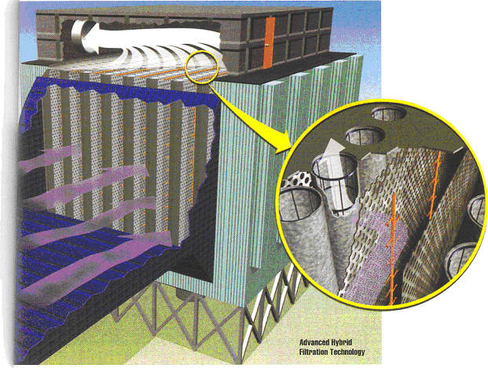
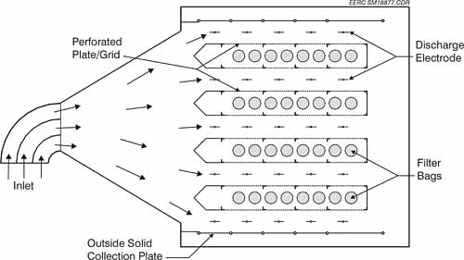
Hybrid Particulate Control Technologies - Advanced Hybrid
The internal geometry consists of alternating rows of ESP components (discharge electrodes and collecting plates) and filter bags within the collector
The inlet flue gas is directed into the ESP zone, which removes most of the entrained dust prior to it reaching the filter bags

Slide 12
Hybrid Particulate Control Technologies - ESFF/MAX9
  Electrostatically-Stimulated Fabric Filters, ESFF (now marketed by GE-BHA under the trade name MAX-9) have been developed by EPA to reduce fabric filter pressure drop and particle penetration

Slide 13
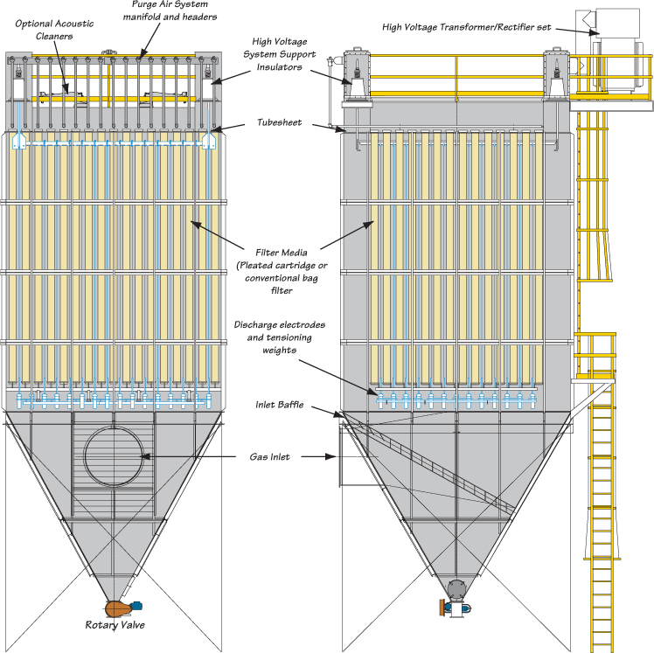
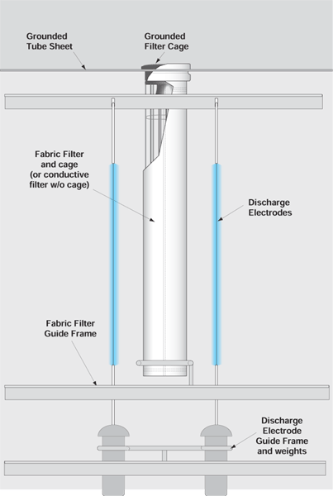
Hybrid Particulate Control Technologies - ESFF/MAX9

Slide 14
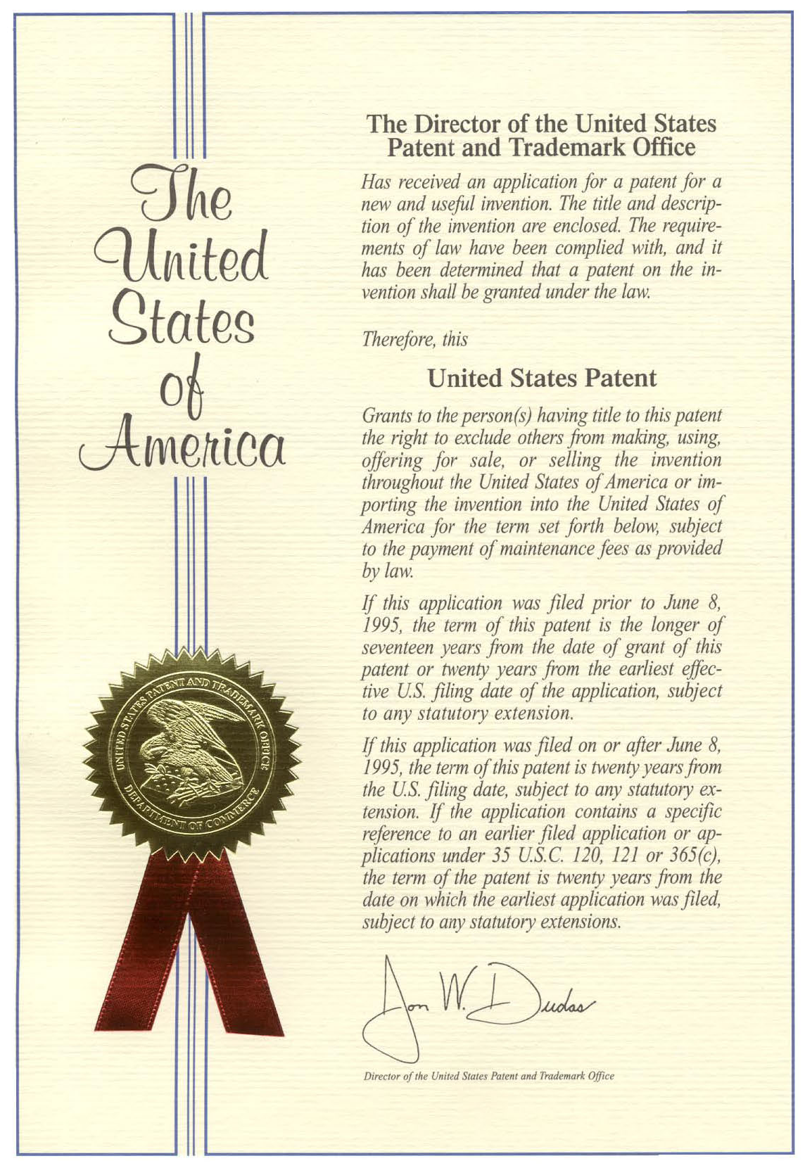
Multi-Stage Collector
(MSC™ )

Slide 15
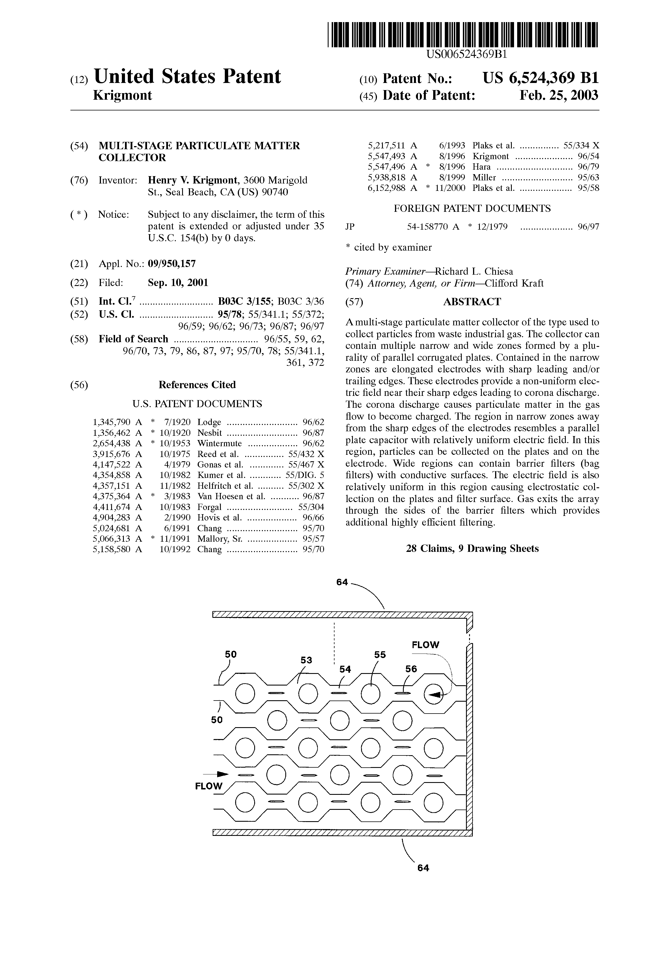
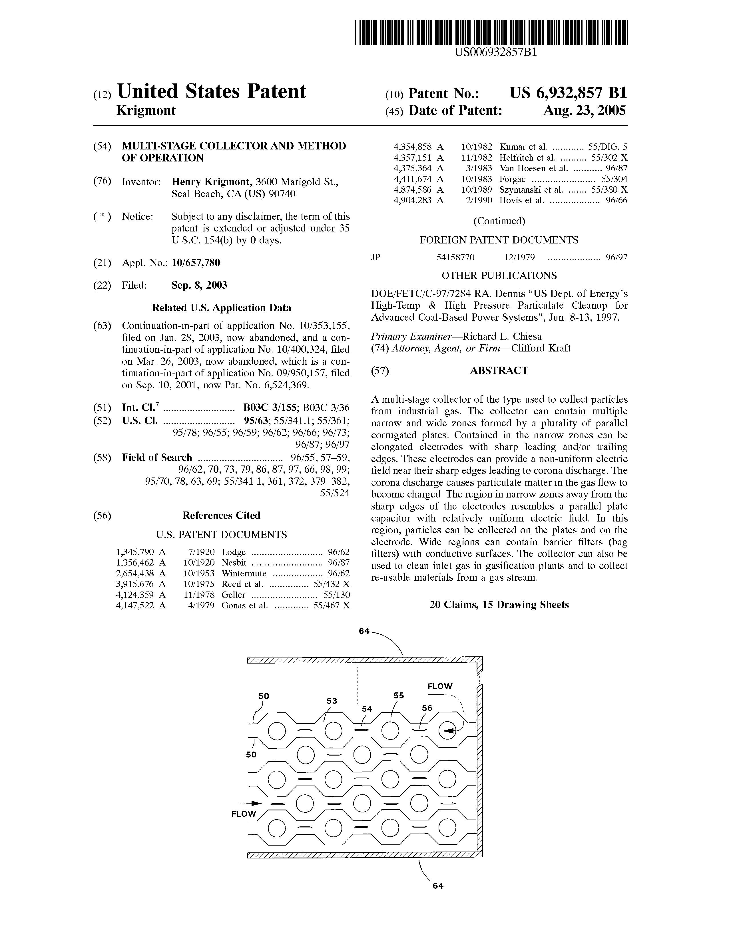
Multi-Stage Collector - MSC™

Slide 16
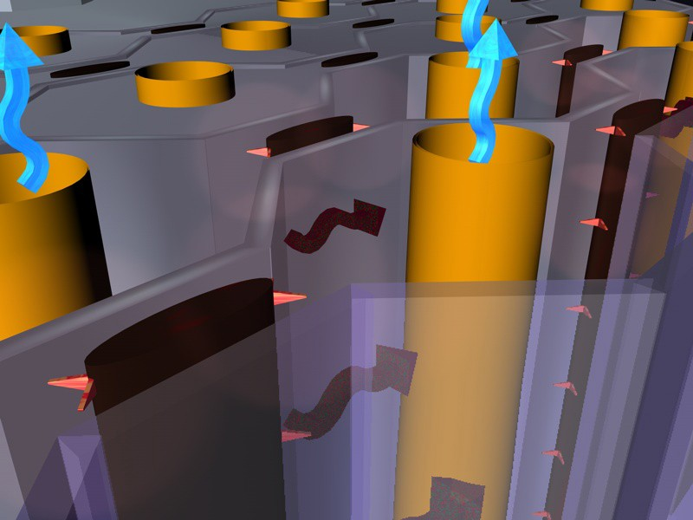
Multi-Stage Collector - MSC™
The MSC™ assembly is made up from DEs placed between oppositely charged corrugated plates
The DEs are followed by BFEs located in wide zones placed between the collecting electrodes
Both the flat sides of each of the DEs, corrugated plates and the surfaces of the BFE. form collecting surfaces where the electric field is relatively uniform

Slide 17
Multi-Stage Collector - MSC™
The principal objective of the MSC™ design is to substantially improve fine particulate collection by:
  combining electrostatic charging, collection and filtration processes, and
  separating zones for particles charging and collecting

Slide 18
Multi-Stage Collector - MSC™
The MSC™ concept can be broadly summarized as a system in which multiple conventional stages are utilized.
Each stage performing its primary function, and
Multiple stages operating synergistically to provide significantly improved performance

Slide 19
Multi-Stage Collector - MSC™
The MSC™ offers a uniquely compact concept utilizing:
  a stage comprised of a conventional ESP

Slide 20
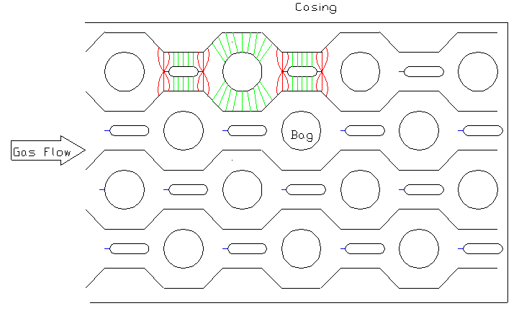
Multi-Stage Collector - MSC™
+
-
+
-
+
-
Stage-1 (Non-Uniform Field): Charging
+
-
+

Slide 21
Multi-Stage Collector - MSC™
The MSC™ offers a uniquely compact concept utilizing:
  an upstream stage comprised of a conventional ESP,
  followed by a zone of parallel surfaces creating uniform electric field

Slide 22
Multi-Stage Collector - MSC™
Stage-2 (Uniform Filed): Precipitation
Stage-2 (Uniform Filed): Precipitation
+
-
+
-
+
-
Stage-1 (Non-Uniform Field): Charging
+
-
+

Slide 23
Multi-Stage Collector - MSC™
The MSC™ offers a uniquely compact concept utilizing:
  an upstream stage comprised of a conventional ESP,
  followed by a downstream zone of the parallel surfaces creating uniform electric field,
  followed by yet another stage, which incorporates barrier filter surfaces of which provide yet additional zone with uniform electric field

Slide 24
Multi-Stage Collector - MSC™
Stage-2 (Uniform Filed): Precipitation
Stage-2 (Uniform Filed): Precipitation
Stage-3 (Barrier Filter): Filtration
+
-
+
-
+
-
Stage-1 (Non-Uniform Field): Charging
+
-
+

Slide 25
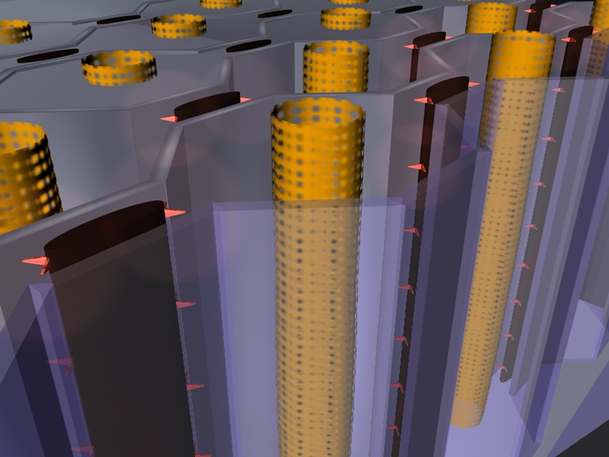
Multi-Stage Collector - MSC™
Stage-3 (Barrier Filter): Filtration
Stage-2 (Uniform Filed): Precipitation
Stage-2 (Uniform Filed): Precipitation
Stage-1 (Non-Uniform Field): Charging

Slide 26
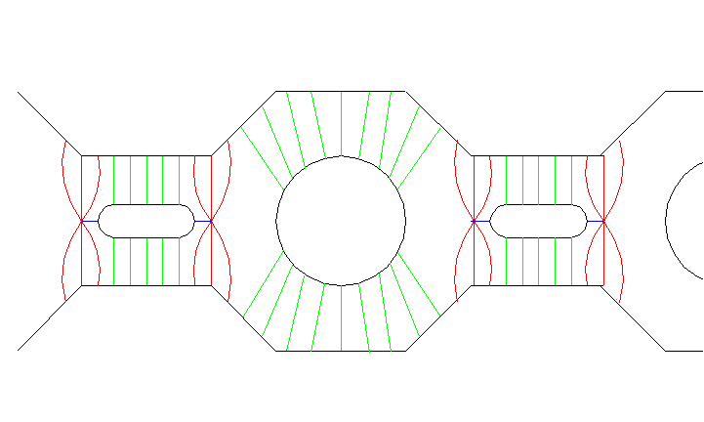
Multi-Stage Collector - MSC™
The center region of uniform field on the other hand acts in a manner similar to the field between parallel capacitor plates with charged dust particles collecting on the plates of opposite polarity
The center region of uniform field on the other hand acts in a manner similar to the field between parallel capacitor plates with charged dust particles collecting on the plates
At sufficiently high field strength in this non‑uniform field region, a corona discharge can take place between the electrode and the plates acting as an ion-charging source for dust particles passing through it
+
+
-
-
-
+
+

Slide 27
MSC™ Effectively Deals with Bi-Polar Charges
Gas Flow
Gas Flow
-
+
-
Dust
-
Dust
+
Clean
Clean
Dust
Dust
Gas
+
Gas
-

Slide 28
Multi-Stage Collector - MSC™
MSC™, by providing continuously repeated stages in series, ensures that the downstream zones effectively re-charge and re-collect the particles that are either uncollected or reentrained

Slide 29
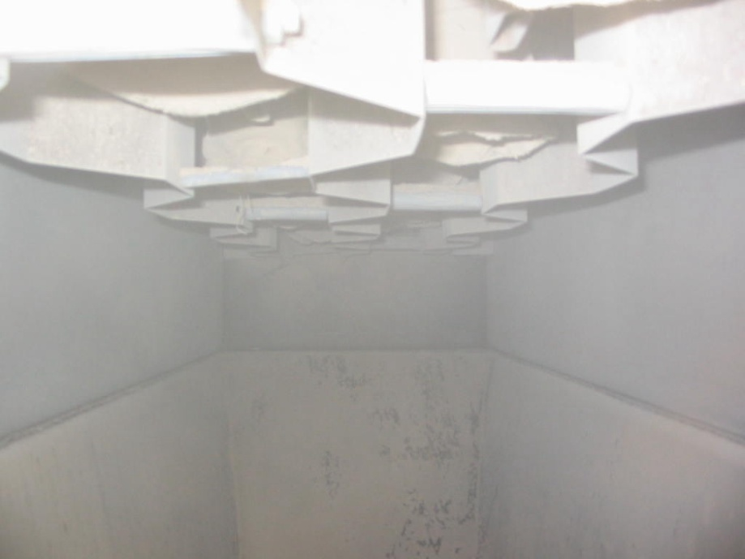
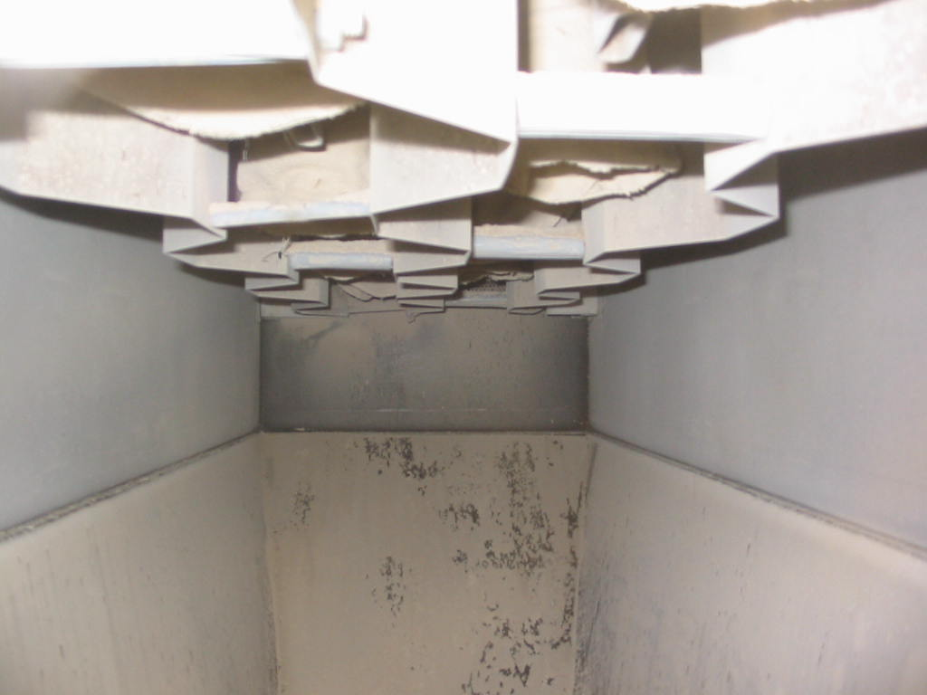
MSCTM Pilot Tests
Field Off
Field On

Slide 30
MSCTM Pilot Tests: Pressure Drop Characteristics

Slide 31
MSCTM Pilot Tests: Pressure Drop Characteristics

Slide 32
MSCTM Pilot Tests: Collection Efficiency

Slide 33
MSCTM Pilot Tests: Emissions

Slide 34
MSCTM Pilot Tests: Penetration vs. Particle Size

Slide 35
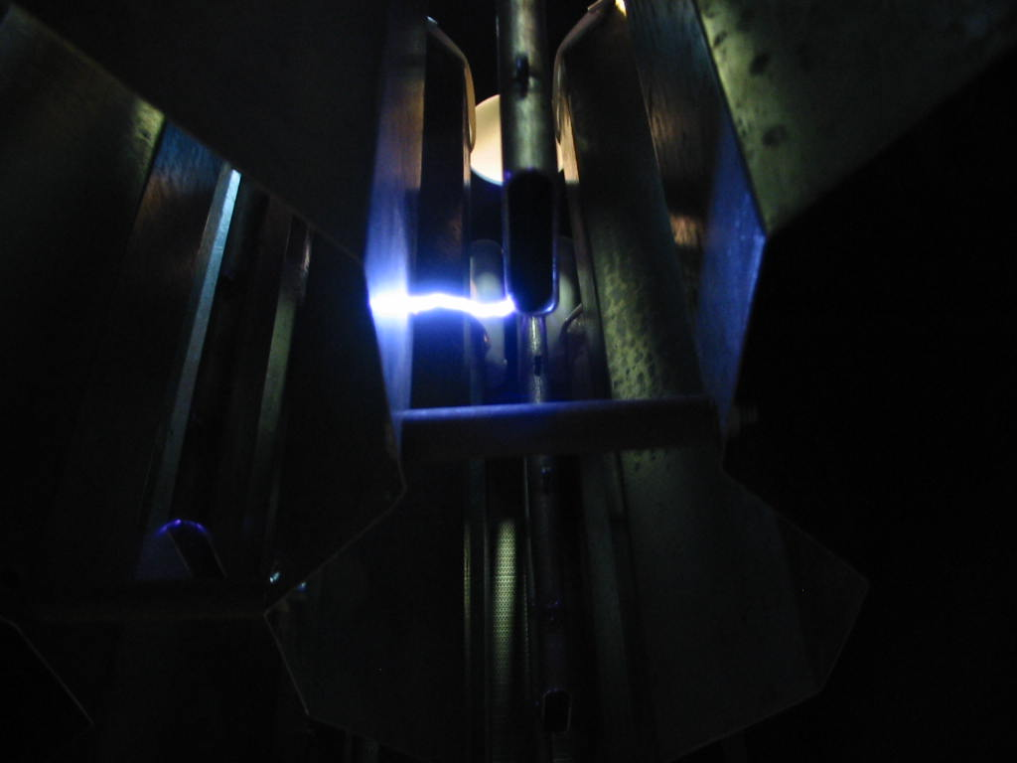
MSC™ Proof of Concept Pilot
Sparking Between the Discharge and Collecting Electrodes.

Slide 36
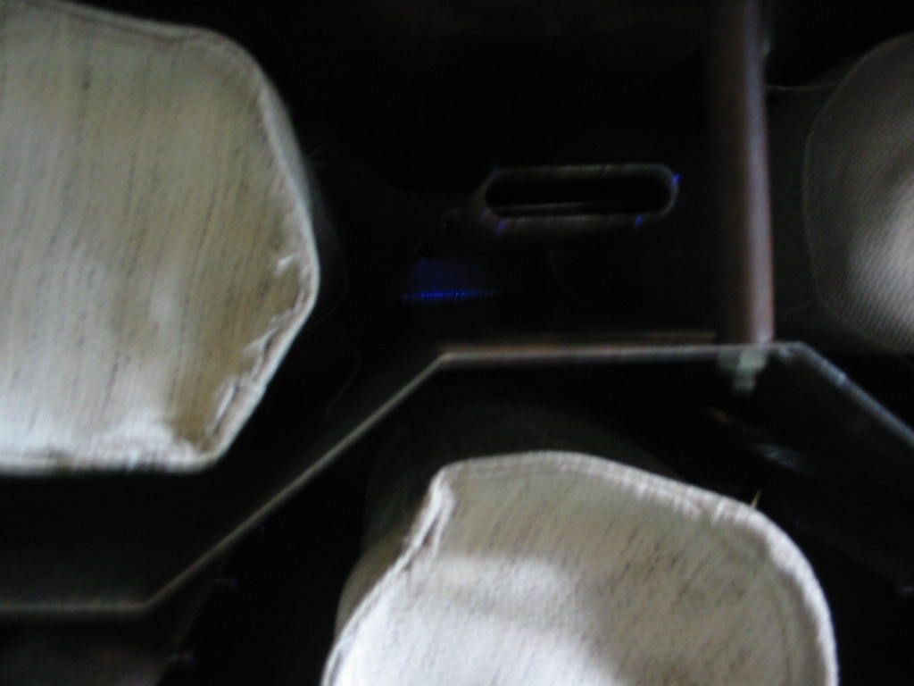
MSC™ Proof of Concept Pilot
Corona Discharge

Slide 37
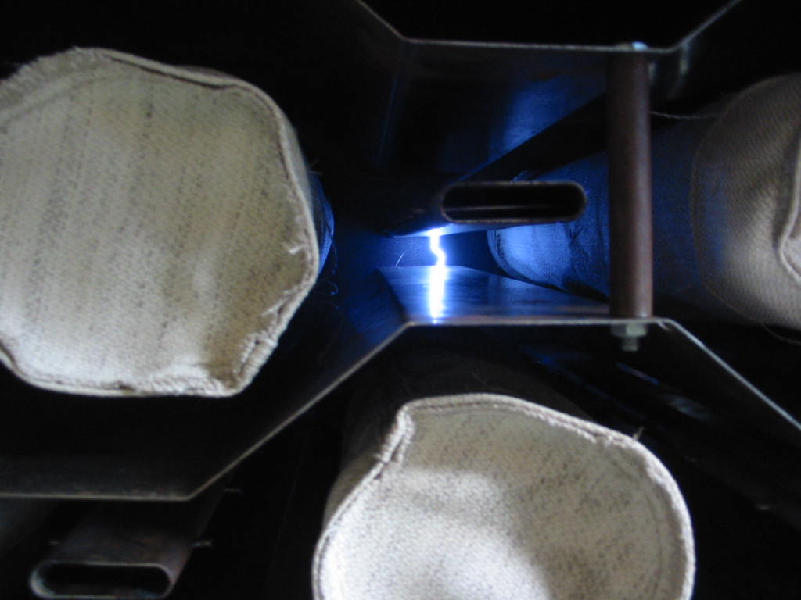
MSC™ Proof of Concept Pilot
Sparking Between the Discharge and Collecting Electrodes.

Slide 38
Multi-Stage Collector - MSC™
Fundamental Differences

Slide 39
MSCTM & Hybrid Technologies – Fundamental Differences
  It is well-known fact that the electrical charge imparted on the aerosol particles is proportional to the applied electrical field and the particle size
  Furthermore, the effective migration velocity, which determines the collection efficiency, is also proportional to the applied electrical filed that moves the charged particulate from the gas stream towards (a) collecting plates and (b) bags
  Therefore, in order to effectively charge and collect the sub-micron particulate, the collecting device must provide
    effective, and rapid particulate charging, and
    to be able to operate with the extremely high electrical field

Slide 40
MSCTM & Hybrid Technologies – Fundamental Differences
  Space charge is a phenomenon, which could be defined as a charge present in the inter-electrode space (between two or more oppositely charged electrodes) due to the flow of ions, or a cloud of the charged particles
  Since the mobility of the charged dust is much lower than the mobility of the ions and electrons, the cloud of charged dust represents a significant increase in space charge, which tends to quench the corona current

Slide 41
MSCTM & Hybrid Technologies – Fundamental Differences
  The space charge imposed by the cloud of the charged particulate matter, however, would be greatly dependent on the particle size distribution, for the same particulate mass could be represented by a few big particles or a large number of the smaller ones
  This would present even more problems when dealing with the cloud of the charged fumes or smoke with MMD of less than 1 micron (sub-micron range).
  Assuming further that the mobility of the particulate is somewhat similar, the cloud of the finer charged matter could present a barrier (or obstacle) to the ions in their quest to carry charges from one electrode to the other. Hence, the other phenomenon called “corona quenching.”

Slide 42
MSCTM & Hybrid Technologies – Fundamental Differences
  It is necessary to operate the corona discharge electrodes at an electrical operating voltage above the corona onset voltage.
  The corona onset voltage is that voltage at which the gas immediately adjacent to the corona discharge electrode starts to ionize because of the very high electric field formed at the curved surface, which then transfers the charge to the particles.

Slide 43
MSCTM & Hybrid Technologies – Fundamental Differences
COHPAC
  ESP & PJBH in Series
  Very Limited Dust Cake Electrostatic Enhancement
  Selected Collection of the Large Fractions in the ESP Impacts the Dust Cake Performance
  All High Resistivity Problems Remain (Back Corona, etc.)

Slide 44
MSCTM & Hybrid Technologies – Fundamental Differences
Advanced Hybrid
  ESP & PJBH in Series
  The Main Idea of the Advanced Hybrid Operation Predicated on the Dust PRE-COLLECTION in the ESP Section
    All High Resistivity Problems Remain (Back Corona, etc.)
    As soon as the corona quenching phenomena settles in, the precipitator section efficiency would significantly diminish, thus the overall unit performance

Slide 45
MSCTM & Hybrid Technologies – Fundamental Differences
Advanced Hybrid
  Very Limited Dust Cake Electrostatic Enhancement
    especially after switching to the tri-electrode geometry to prevent sparking to the bags
  Selected Collection of the Large Fractions in the ESP Impacts the Dust Cake Performance

Slide 46
MSCTM & Hybrid Technologies – Fundamental Differences
ESFF/MSX9
  The corona onset voltage is a function of the gas temperature and density, corona discharge electrode diameter, its distance from the bags, and the surface roughness of the electrode.
  The corona onset voltage for an electrode increases with its diameter and distance from the bags, and decreases with the surface roughness.

Slide 47
MSCTM & Hybrid Technologies – Fundamental Differences
ESFF/MSX9
  In this device the charging electrodes are located in the very proximity to the bags, hence to eliminate the chance of the sparking towards the bag, which would cause the bag puncture, the high voltage has to be reduced to the minimum possible
  Therefore, if the space charge occurs, instead of the increasing the applied voltage to overcome the charged particulate cloud, the system would have to reduce the voltage in order not to overcome the sparking threshold
  Hence, defeating the effective sub-micron particles charging and collection

Slide 48
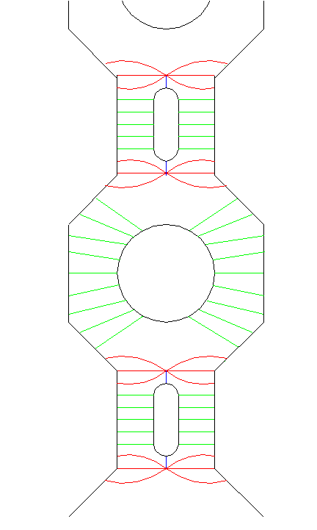
MSCTM & Hybrid Technologies – Fundamental Differences
What Differentiate the MSC™ from Other “Hybrid” Technologies?
Gas Flow
The MSC™ is engineered in such a way that the BFE and the DE are grounded while the corrugated electrodes are suspended from the insulators
By virtue of having the BFE’s at the same potential as the DE’s, the MSC™ design virtually eliminates any potential sparks from the DE toward the BFE
Contrary to other technologies, whose performance is greatly dependent on the dust resistivity and could be virtually “halted” when back corona develops, the MSC™ offers an efficient collection mechanism for the bi-polar particles. Thus, in effect, making it virtually independent of the dust (product) electrical resistivity.
+
-
+
-
+
-
+

Slide 49
MSCTM & Hybrid Technologies – Fundamental Differences
Multi Stage Collector (MSCTM) Technology
  The high voltage in the MSC™ device is not limited by the sparking towards the bags.
  Hence, it could operate with the maximum possible applied high electric field to ensure the most effective sub-micron particulate charging and collection.
  Furthermore, by utilizing combination of the single- and two-stage electrostatic precipitation, the MSC™ technology offers the best possible combination of the non-uniform and uniform high-tension electric fields for the most efficient aerosol charging and collection.

Slide 50
Multi-Stage Collector - MSC™
Independent Research

Slide 51
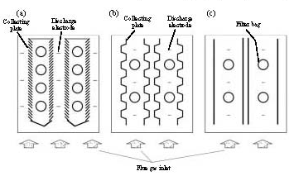
Multi-Stage Collector - MSC™
Korea Institute of Energy Research

Slide 52
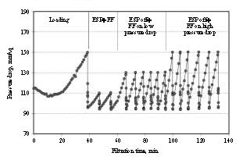
Multi-Stage Collector - MSC™
Korea Institute of Energy Research

Slide 53
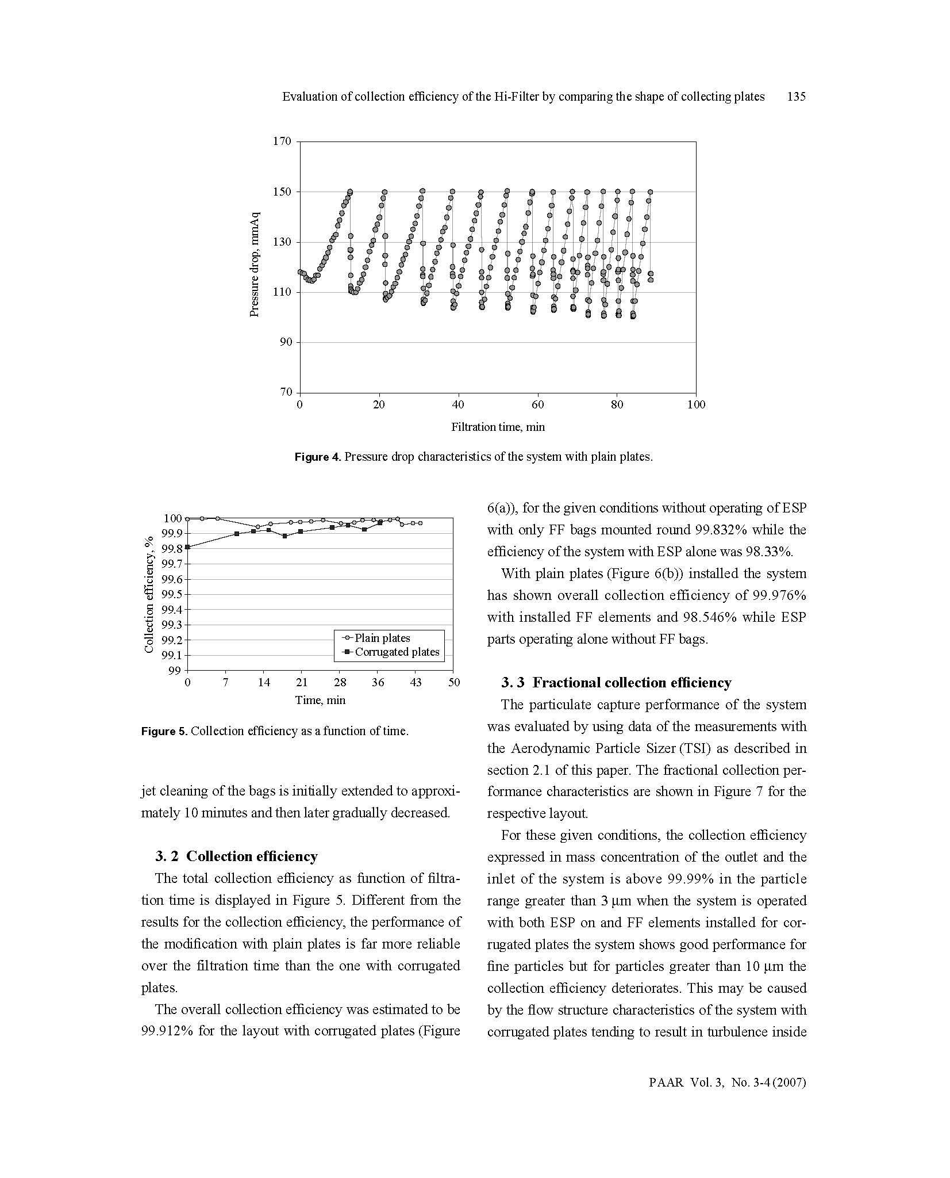
Multi-Stage Collector - MSC™
Korea Institute of Energy Research

Slide 54
Multi-Stage Collector - MSC™
Korea Institute of Energy Research

Slide 55
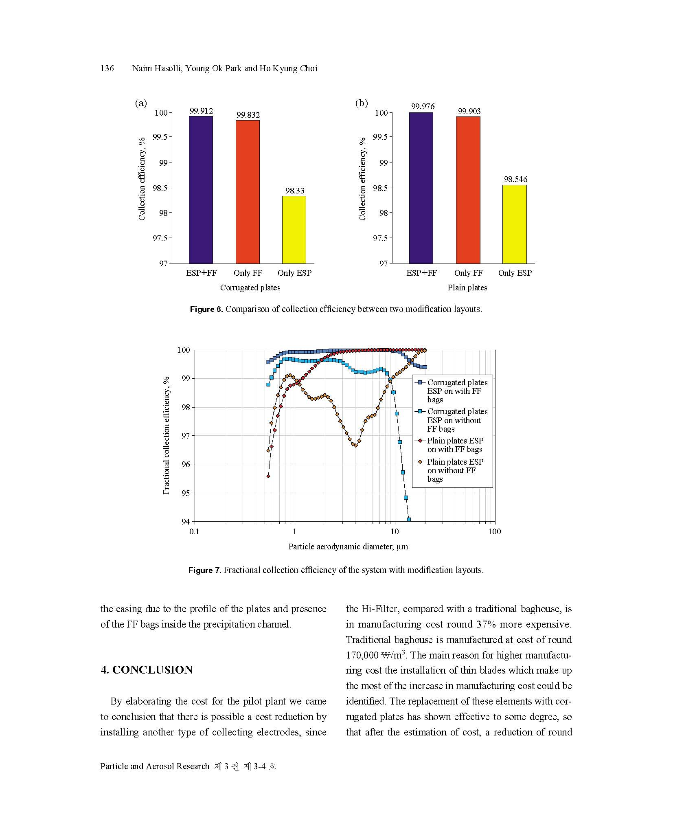
Multi-Stage Collector - MSC™
Korea Institute of Energy Research

Slide 56
Multi-Stage Collector - MSC™
Korea Institute of Energy Research

